Slide 1



SMART ATTENDANCE SYSTEM USING FACE RECOGNITION
A Mini Project work by
B Shiva Kumar - 17H61A0467
Bharath Kumar Kairoju - 17H61A0470
Hazari Sai Jagadeesh - 17H61A0482
Under the guidance of
Dr.D.Narendhar Singh
(Associate Professor, ECE)

Slide 2

OVERVIEW
Authentication is one of the significant issues in the era of information system. Among other things, human face recognition (HFR) is one of known techniques which can be used for user authentication. However, it is difficult to estimate the attendance precisely using each result of face recognition independently because the face detection rate is not sufficiently high.
Continuous observation improves the performance for the estimation of the attendance we constructed the lecture attendance system based on face recognition, and applied the system to classroom. This paper first review the related works in the field of attendance management and face recognition. Then, it introduces our system structure and plan.
Finally, experiments are implemented to provide as evidence to support our plan. The result shows that continuous observation improved the performance for the estimation of the attendance.

Slide 3
Problem statement
Attendance of the student is very important for every college, universities and school.
Conventional methodology for taking attendance is by calling the name or roll number of the student and the attendance is recorded.
Time consumption for this purpose is an important point of concern.
Assume that the duration for one subject is around 60 minutes or 1 hour & to record attendance takes 5 to 10 minutes.
For every tutor this is consumption of time.
To stay away from these losses, an automatic process is used in this project which is based on image processing.

Slide 4
OBJECTIVEs
The objective of this project is to develop face recognition attendance system. Expected achievements in order to fulfill the objectives are:
To detect the face segment from the video frame.
To extract the useful features from the face detected.
To classify the features in order to recognize the face detected.
To record the attendance of the identified student

Slide 5
METHODOLGY
In this project face detection and face recognition is used.
Face detection is used to locate the position of face region and face recognition is used for marking the understudy’s attendance.
The database of all the students in the class is stored and when the face of the individual student matches with one of the faces stored in the database then the attendance is recorded.

Slide 6
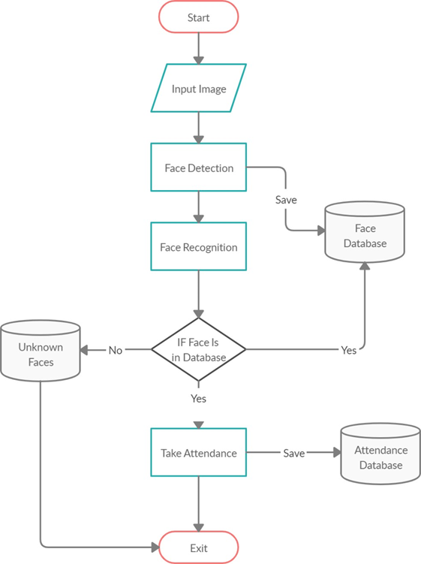
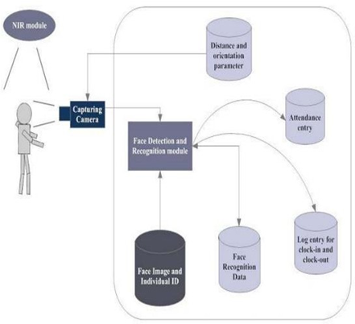
Block diagram

Slide 7
SOFTWARE and hardware Requirements
OpenCV: We used OpenCV 3 dependency for python 3. OpenCV is library where there are lots of image processing functions are available. This is very useful library for image processing. Even one can get expected outcome without writing a single code. The library is cross-platform and free for use under the open-source BSD license. Example of some supported functions are given bellow:
Python IDE: There are lots of IDEs for python. Some of them are PyCharm, Thonny, Ninja, Spyder etc. Ninja and Spyder both are very excellent and free but we used Pycharm as it feature- rich than spyder.
Camera

Slide 8
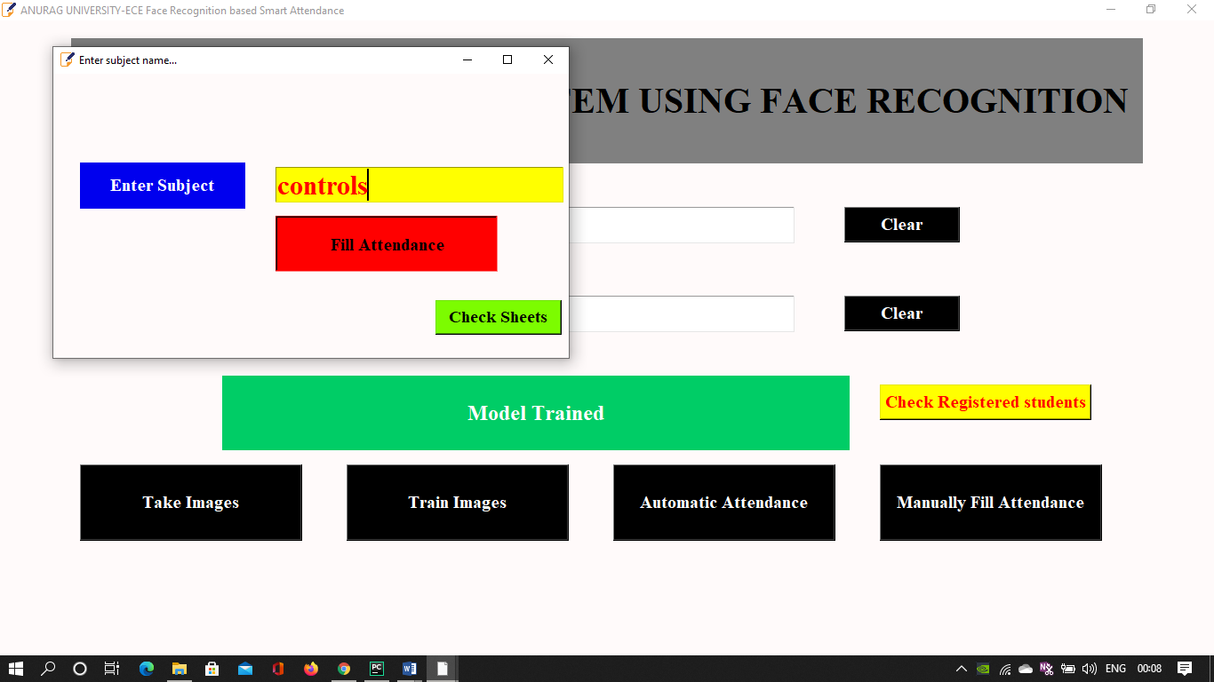
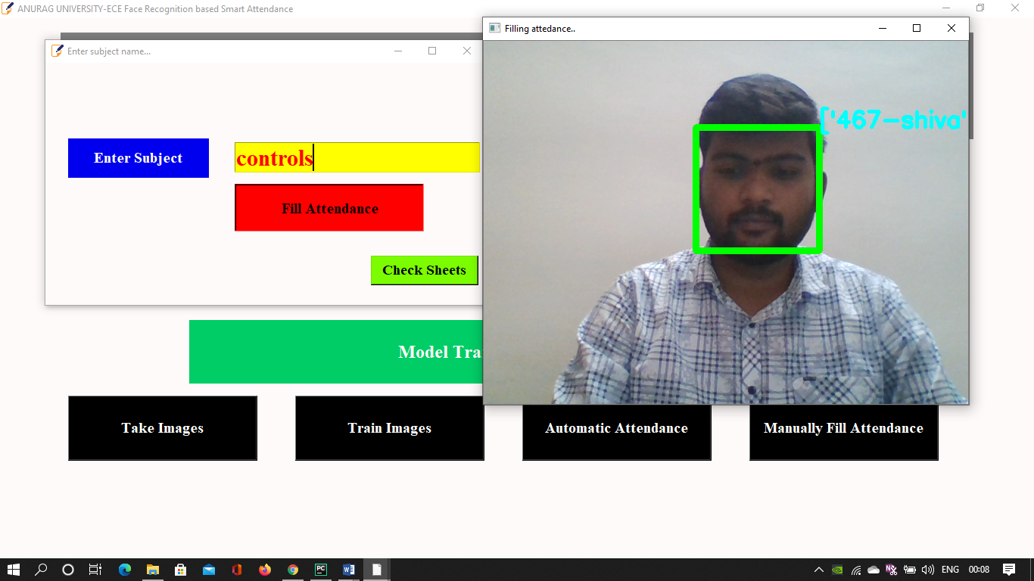
Results

Slide 9
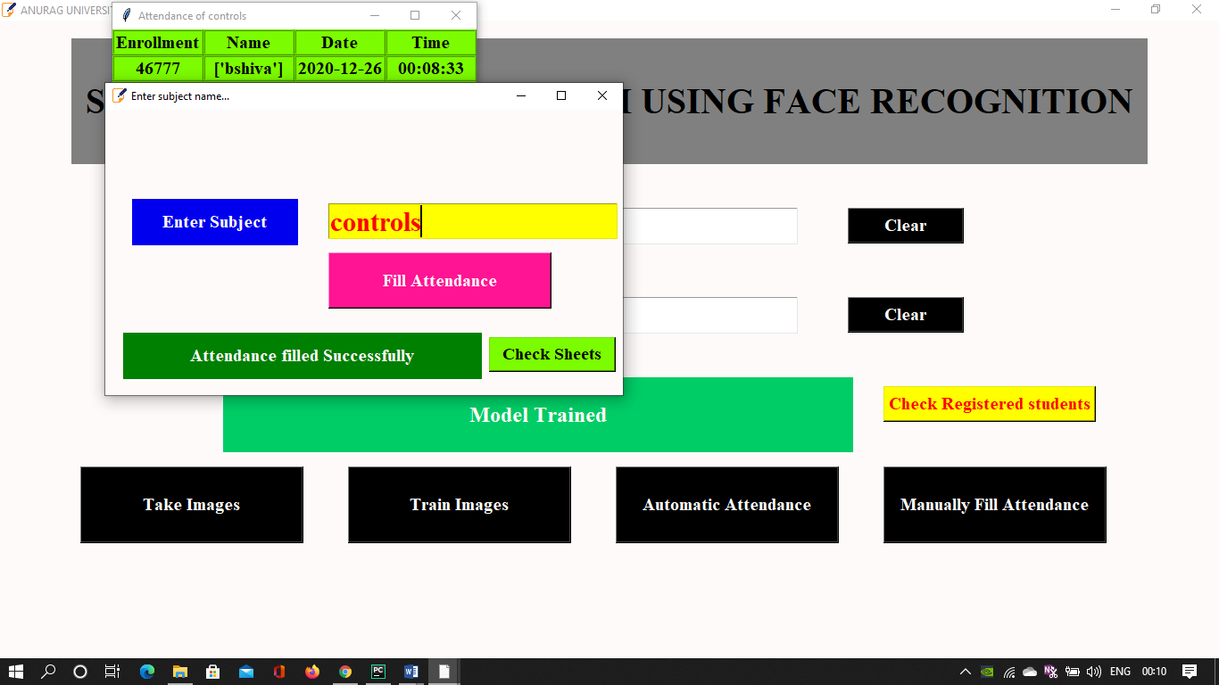
Results
Attendance filled automatically using face recognition

Slide 10
CONCLUSION
From initiation through conclusion of developing this system the following results has been achieved. They are as follows:
The system can be administered by a non-IT technician.
The system is market ready for commercial use.
The system has the capacity to carry up to a thousand faces to recognize.
The system can serve as much people as they want within an organization.

Slide 11
FUTURE SCOPE
There are so many future scope on this project. Some of them are:
Integrate with CC cameras
Can improve security
Can use Neural Network for high accuracy
Can used in big factory or employee attendance
Can build on fully web base system.

Slide 12
references
[1] Ahonen, Timo, Abdenour Hadid, and Matti Pietikainen. “Face description with local binary patterns: Application to face recognition.” IEEE transactions on pattern analysis and machine intelligence 28.12 (2006): 2037–2041.
[2] Ojala, Timo, Matti Pietikainen, and Topi Maenpaa. “Multiresolution gray-scale and rotation invariant texture classification with local binary patterns.” IEEE Transactions on pattern analysis and machine intelligence 24.7 (2002): 971–987.
[3] Ahonen, Timo, Abdenour Hadid, and Matti Pietikäinen. “Face recognition with local binary patterns.” Computer vision-eccv 2004 (2004): 469–481. [4] LBPH OpenCV: https://docs.opencv.org/2.4/modules/contrib/doc/facerec/facerec_tutorial.html#local-binary-patterns-histograms
[5] Local Binary Patterns: http://www.scholarpedia.org/article/Local_Binary_Patterns

Slide 13
Thank you

